Slide 1
The background
Notes:
What I would like to talk to you about is our homepage. And the reasons why I think we should refresh it.

Slide 2
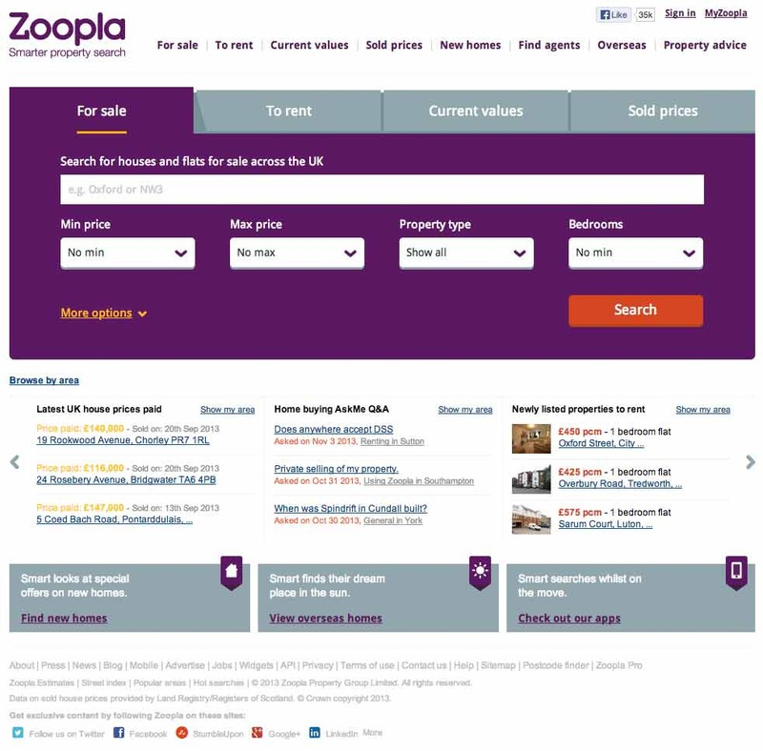
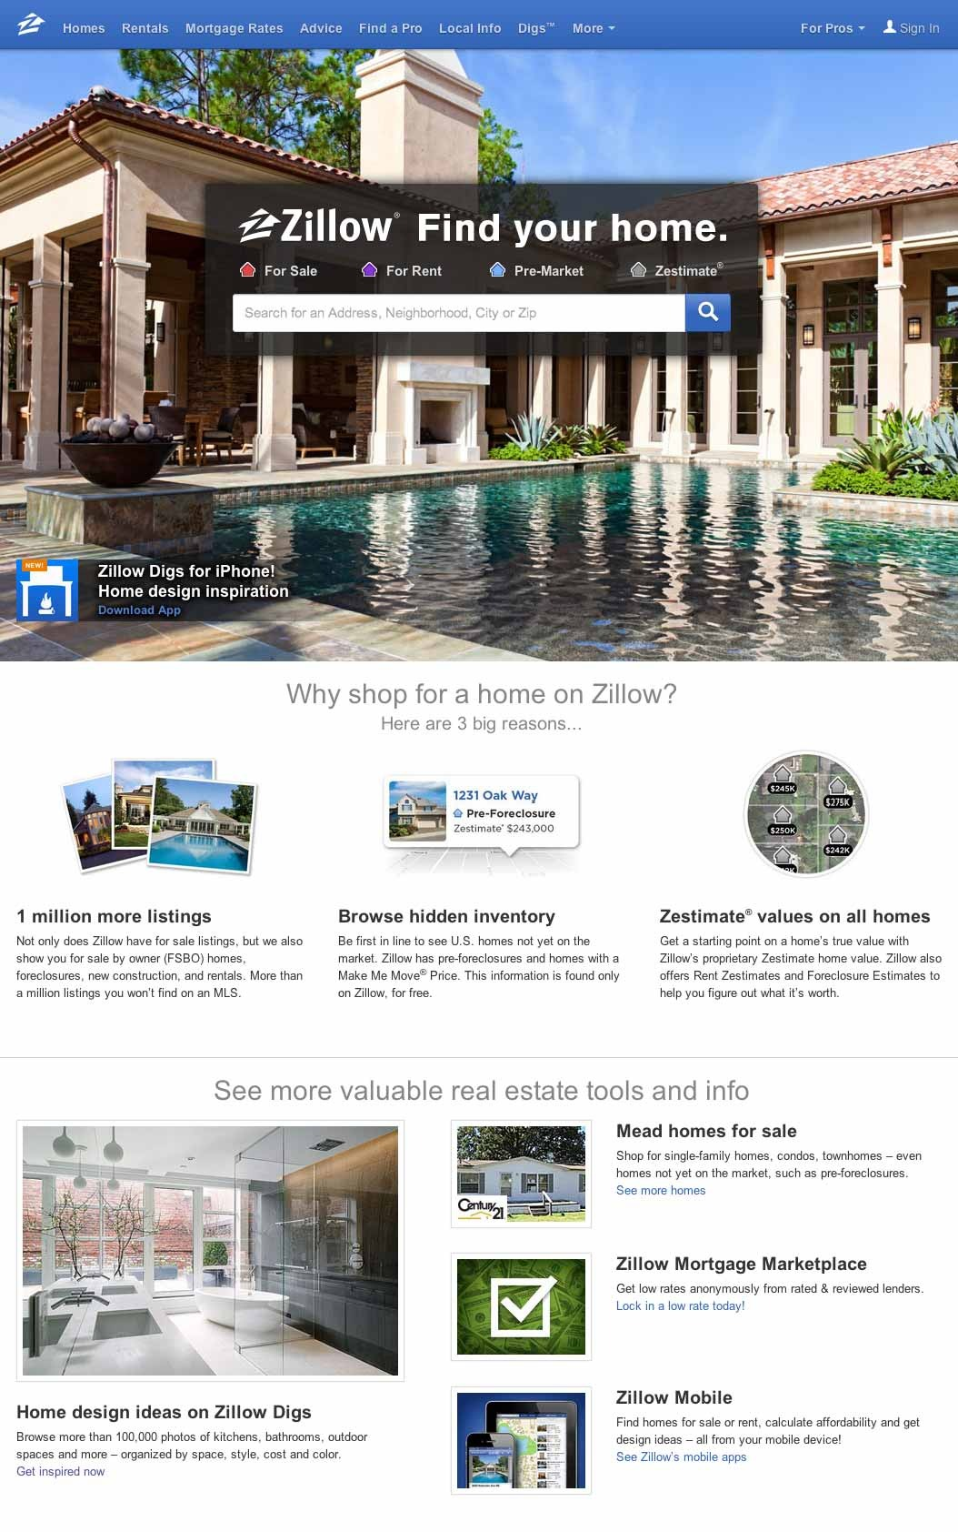
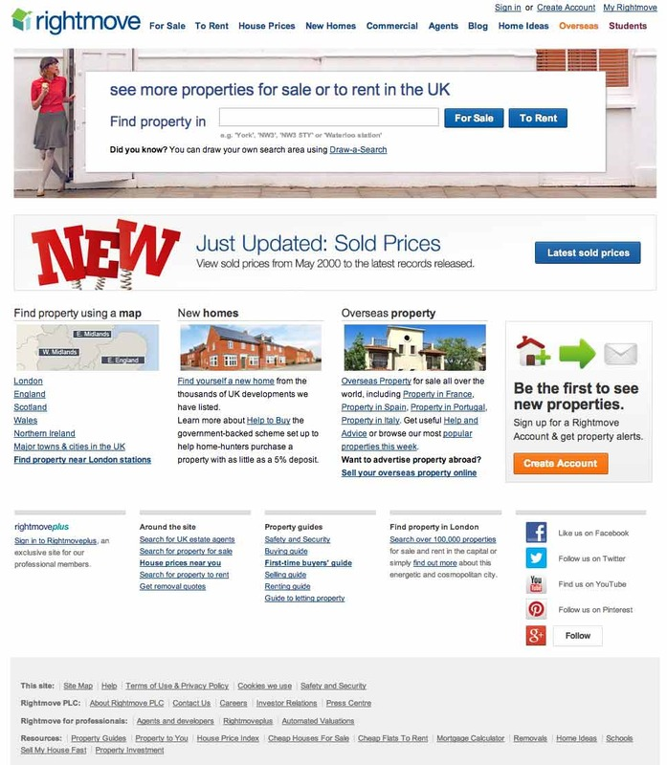
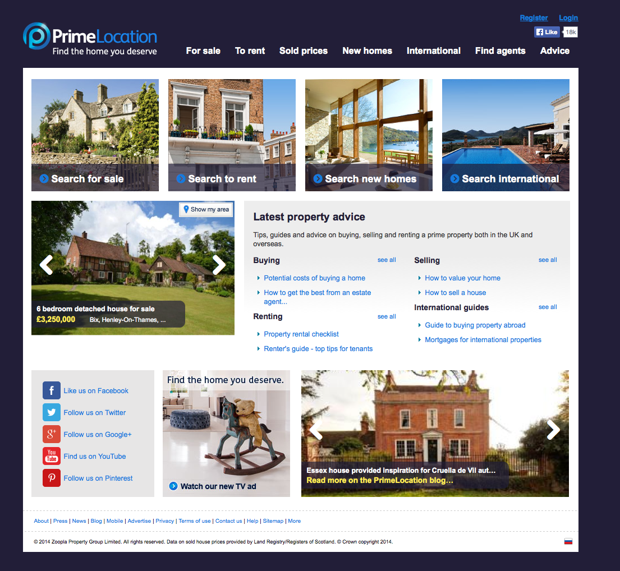
7th Aug 2013
Competitor search analysis
Notes:
Last August we invited our users here at Rightmove to capture some qualitative feedback about the Search mechanism on our site and our competitors’.
The task we assigned them was to perform a search, and then refine it by applying filters on all of the four websites in the slide.
Then we asked them to comment their experience.

Slide 3
Confusing, cluttered
Notes:
What also came out of that session was that users consistently told us that the home pages of both Rightmove and Zoopla, are too cluttered and ‘busy’.
This was unprompted response

Slide 4
5-seconds test
with 110 users
Notes:
So we wanted to find out more with another batch of testing. With a larger sample.
A spread of 50-30-30 unique users were invited to participate to a 5-seconds test. They were shown these pages and then asked few questions

Slide 5
We asked:
What was the first thing that you noticed, or what called out to you most?
Other than the Search, what other 2 features could you have explored on that page?
Could you describe in 3 adjectives the design of the layout you just saw?
What is your impression of this company based on its choice of website design? Did the brand appear trustworthy?
What was your natural response after having seen the layout?
Notes:
First two to understand focal point and memorability. Do users read what’s written on the page?
The other questions were related to website design and how it affects the perception of our brand and the level of engagement

Slide 6
We phrased it differently but we asked:
Is our offering/CTAs clear, visible, and memorable?
How is our presentation/brand perceived?
Does it inspire confidence, trustworthiness?
Is it positive and engaging?
Notes:
So do you see our call to actions?
How good is our presentation and brand perception?

Slide 7
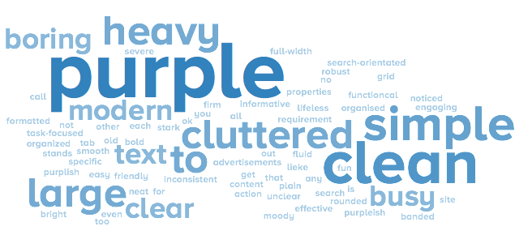
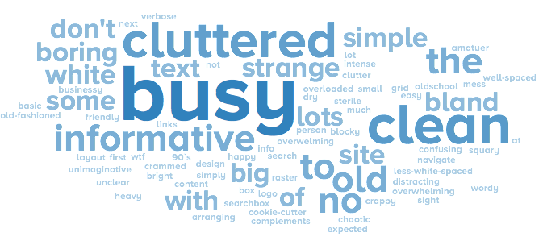
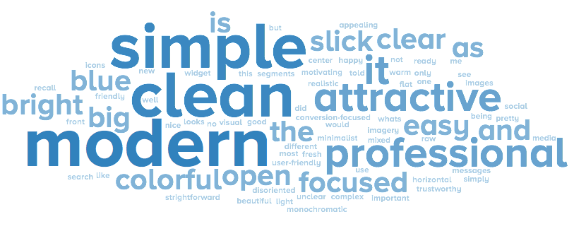
Could you describe in 3 adjectives the design of the layout you just saw?
Notes:
Going clockwise from the left:
Busy, cluttered ---- heavy, purple---- simple, clean modern

Slide 8
What is your impression of this company based on its choice of website design? Did the brand appear trustworthy?
large portfolio, but kind of cheap (not in a good way)
not a start-up, but possibly either a very small, local company or a large, "old school" corporation. Design wasn't "trendy".
Just another spam real estate site.
small, maybe family business
single room office, small time, un secure trends
Start-up company who is trying to use the web as a key launching pad for their service portfolio
Notes:
Old school corporation ---- start-up, cheap ---- spam real estate site

Slide 9
Perceived issues:
Service offering is not entirely clear/visible
Usability and brand perception are poor
Not optimised for touch devices
Design language is dated and unappealing to users
Content is old and text-heavy (mostly designed for SEO rather than users)

Slide 10
16 million
unique pageviews/month
Notes:
We serve this experience to: 16million unique users a month

Slide 11
Perception is one’s reality

Slide 12
Abi
Current situation:
Rented a property via RM
Now property owner and Zoopla user
Cool stuff: in her job she chooses the locations of the James Bond movies

Slide 14
Abi
We all heard: Contemporary brand, Advertise a lot more, my friends use it…
…and she also said:
Quicker on the mark
Moving generation
Technology
More visible
First with prices and location

Slide 15
Notes:
And change from this

Slide 16
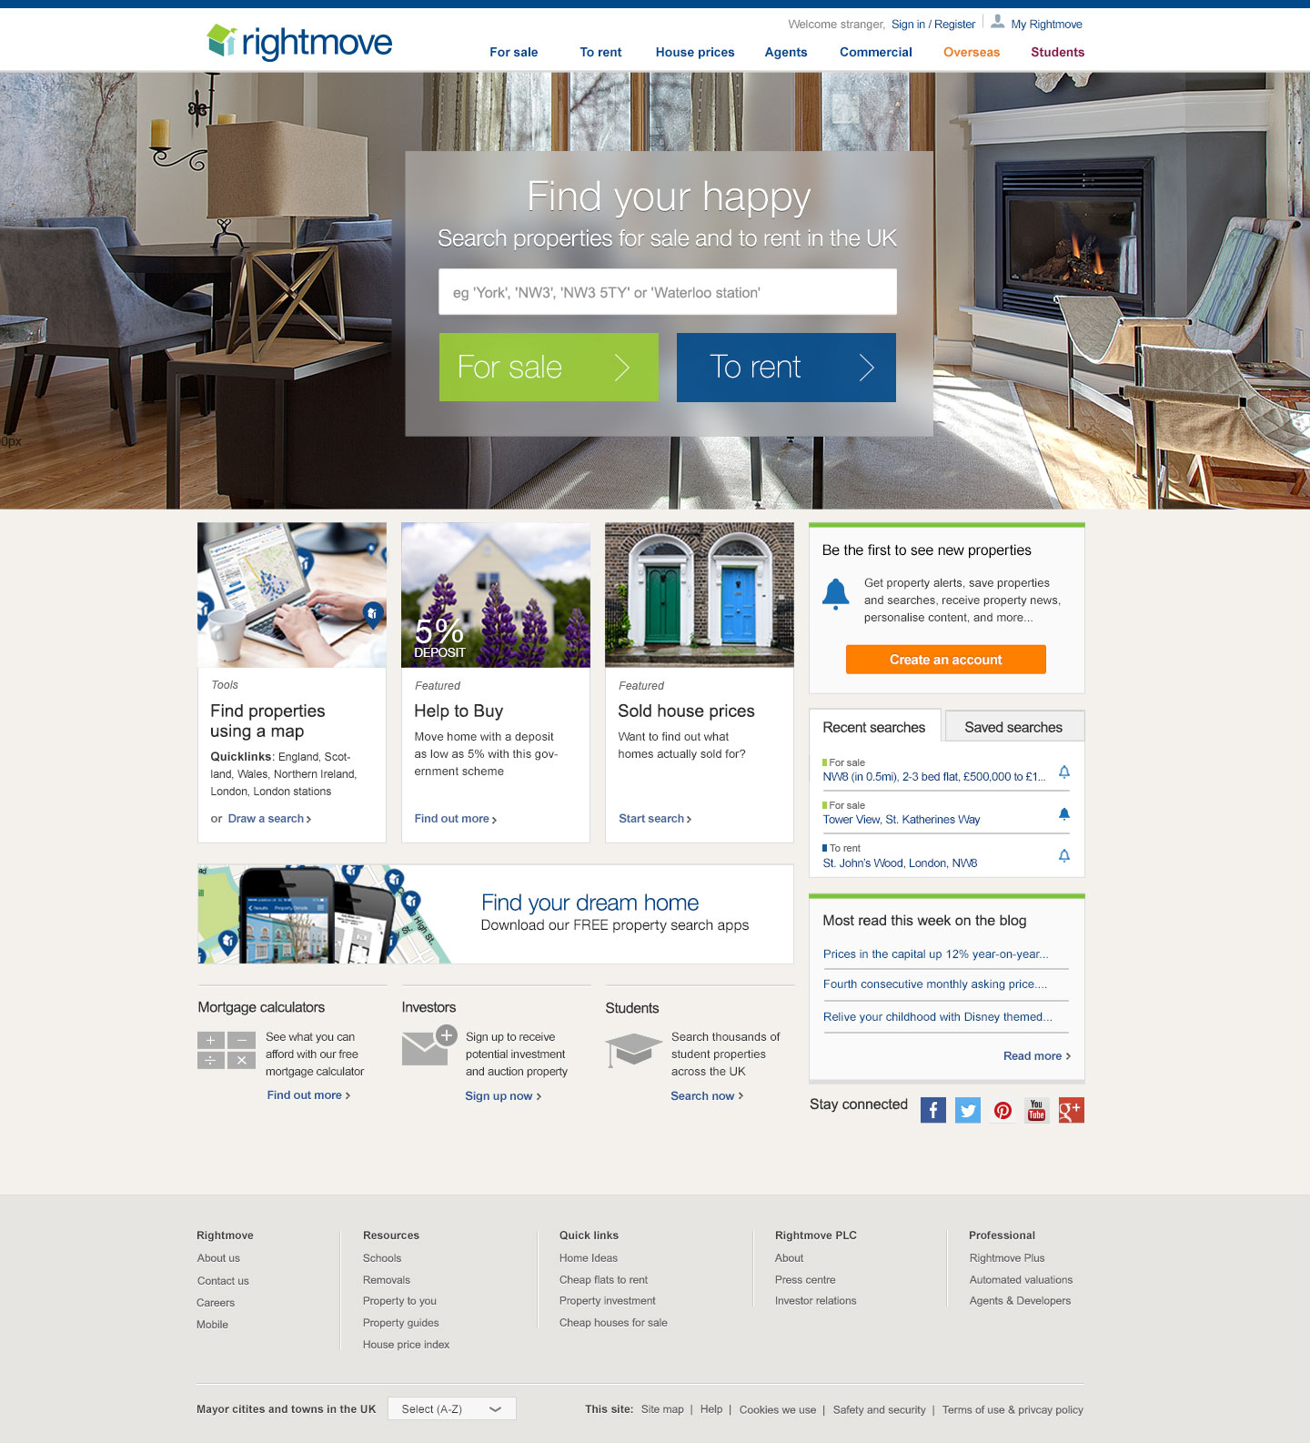
Notes:
To this ------
DISTRIBUTE PRINTOUTS

Slide 17
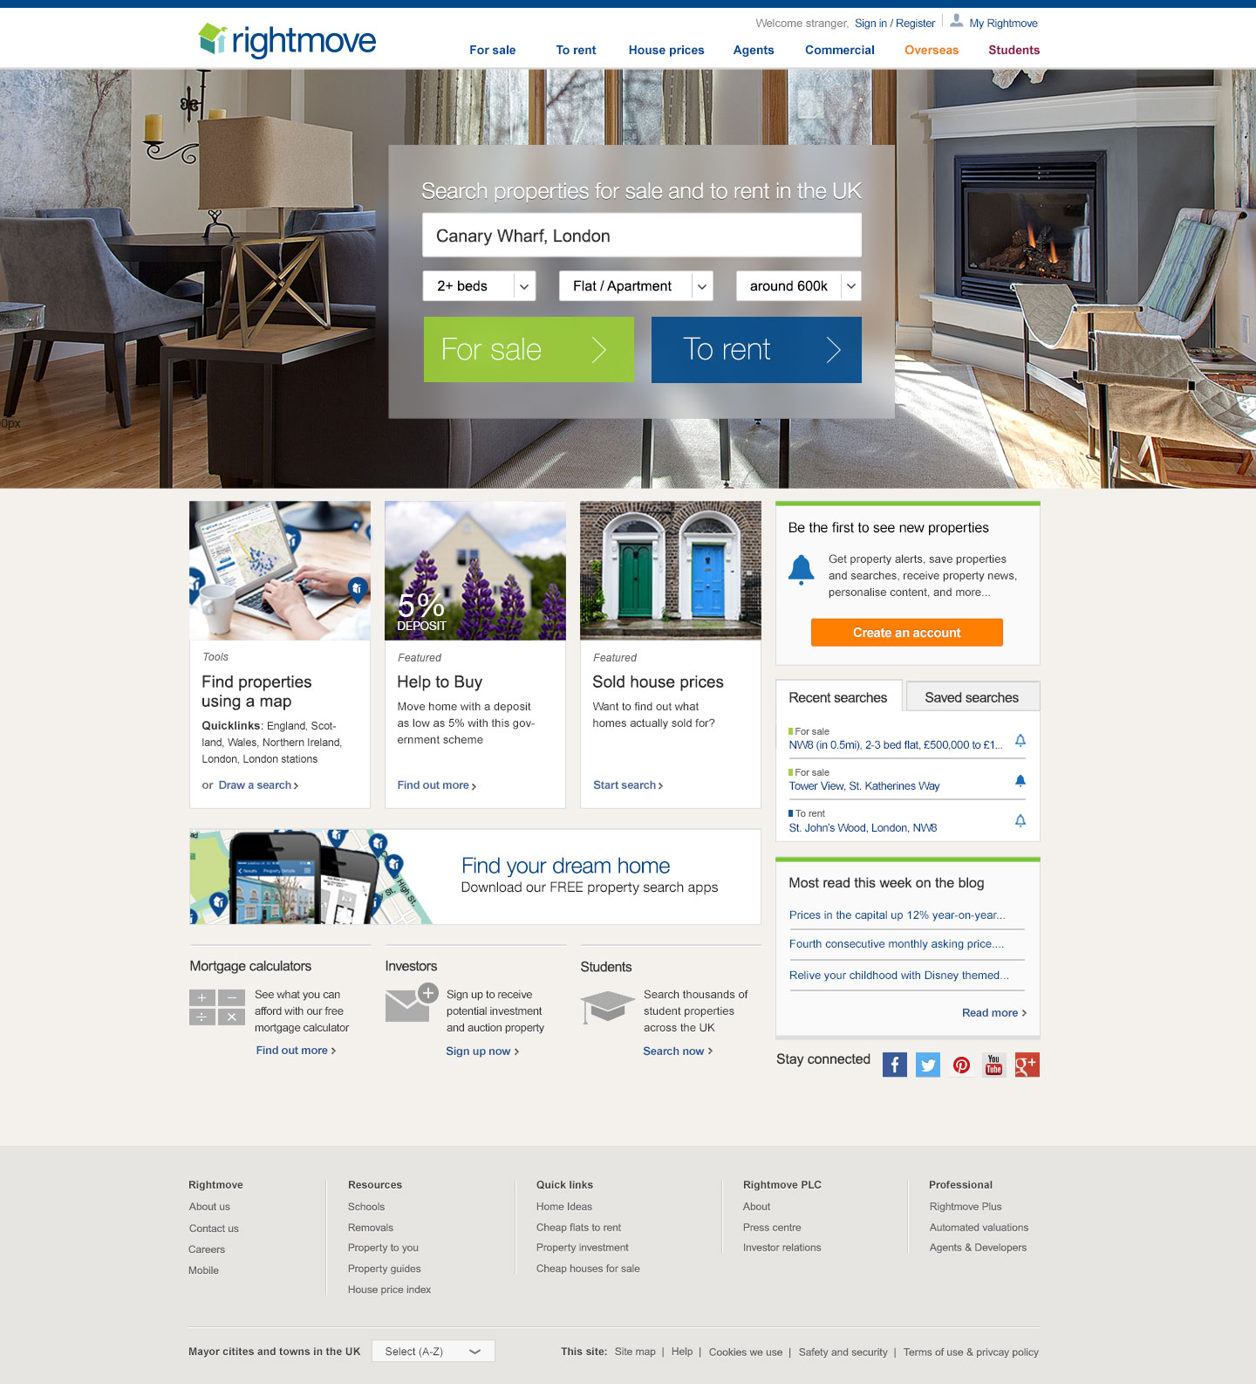
Notes:
Here is the logged in state

Slide 18
De-constructing it
Notes:
Let’s discover together what changed in greater detail

Slide 19
Navigation
Current
Proposed
Links and taxonomy coming from the new Information Architecture
Better spacing and alignments
Logged status and welcome message
SEO friendly implementation
Facebook like button
Notes:
Top nav:
New links, as it make sense to users
Better spacing and alignments
Logged status and welcome message
Non JavaScript so SEO friendly
Facebook like button

Slide 20
Hero (top banner)
Current
Proposed
Fresh and “actiony” strap-line to replace the old ‘see more - eyes’ brand
Larger canvas for images (aspirational/emotional, or marketing-led)
Notes:
Top banner:
No more eyes
Larger space for images to complement our campaigns or to evoke emotional responses

Slide 21
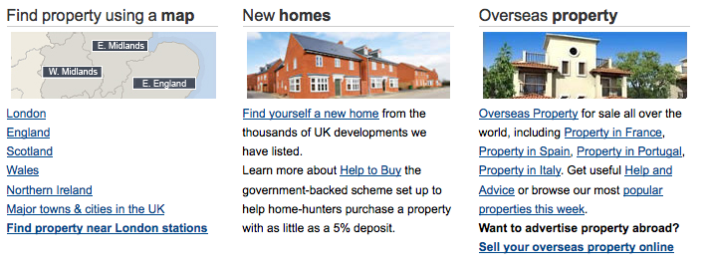
Featured content pods
Current
Proposed
Notes:
Content pods:
Better imagery
Cleared typography
One call to action, not 10 per pod!

Slide 22
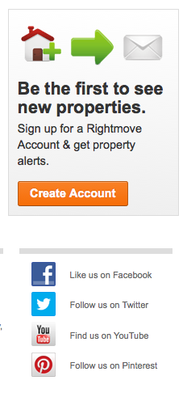
Sidebar
Current
Proposed
Logged-in state
Notes:
Sidebar:
This consist of two states: First visit, and Logged In
The former featuring a clear CTA to get people to register and use the full suite of tools we have to offer.
The latter is a mini dashboard to invite to resume from the previous session and offer a quick peak of what’s new that matches the search criteria
Blog – Content freshness and SEO value

Slide 23
Footer
Current
Proposed
Notes:
Same links but better and more logic grouping

Slide 24
How old and new compare?
Notes:
So

Slide 25
5-seconds test
+100
new participants
Notes:
Another batch of testing
We added a fourth variant to the same test and we invited extra 100 participants.

Slide 26
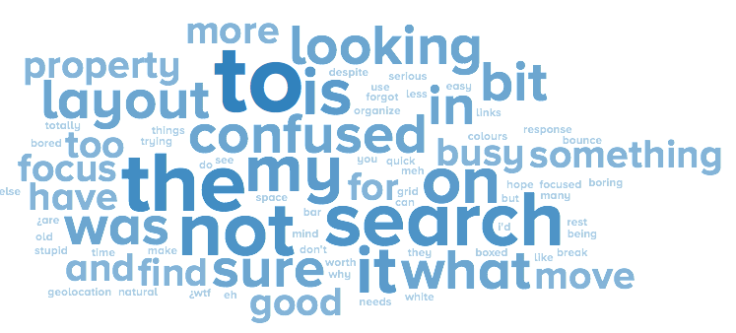
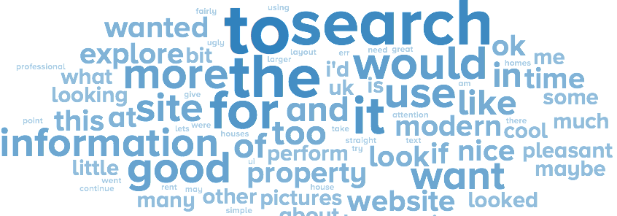
What was your natural response after having seen the layout?
Notes:
Search more ----- Use it ----- Explore

Slide 27
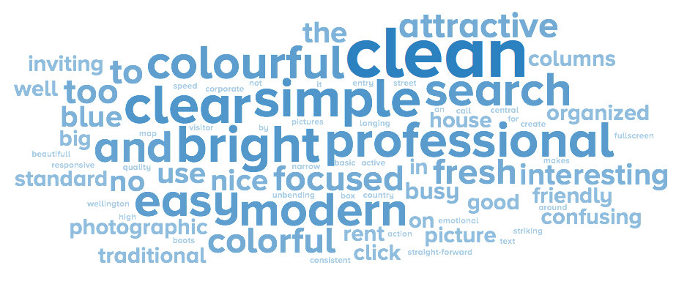
Could you describe in 3 adjectives the design of the layout you just saw?
Notes:
Clean ----- Clear ---- Simple

Slide 28
What is your impression of this company based on its choice of website design? Did the brand appear trustworthy?
Yes it did. The site felt cosy yet professional. Felt like I would want to explore.
Modern and professional company. It offers lots of useful information I’m interested in.
Great design.
Definitely trustworthy. Looks nice, clean.
I can search for a home. It seemed professional and trustworthy.
Good company, big one, Open-minded atmosphere, Absolutely trustworthy. Stable, not stressed out to get you as a customer
Notes:
My favorite is the one at the bottom. I think it’s very insightful

Slide 29
Thank you

