Slide 1
Rightmove.co.uk re-style

Slide 2
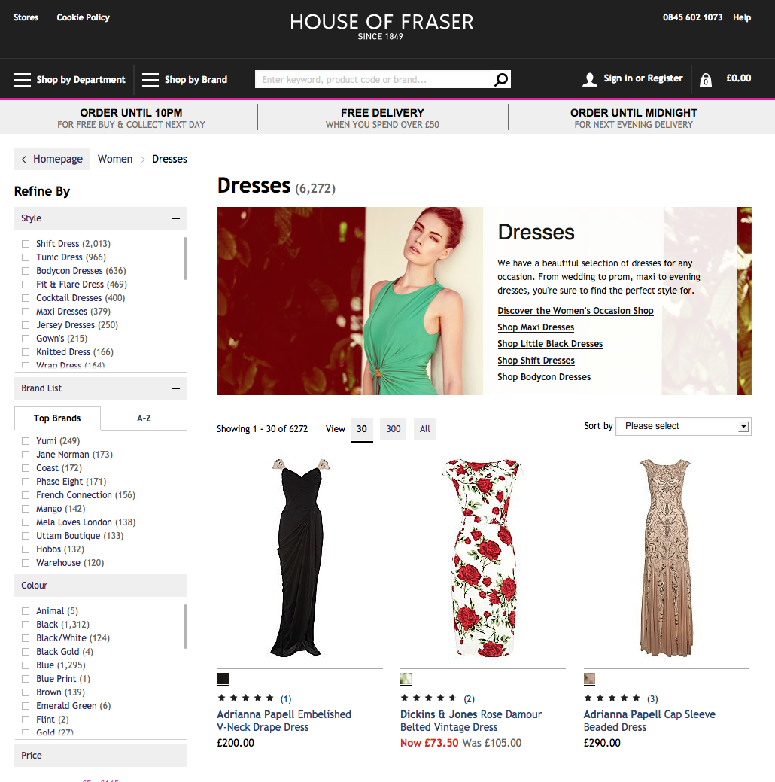
Familiar and learnable
As human beings, we like patterns and recognition, which is why we are better at handling familiar situations rather than unfamiliar ones.
People are familiar with a lot of design concepts used on the web. By using these concepts consistently, we meet our visitors’ expectations. This way, we help them reach their goals more quickly.

Slide 3
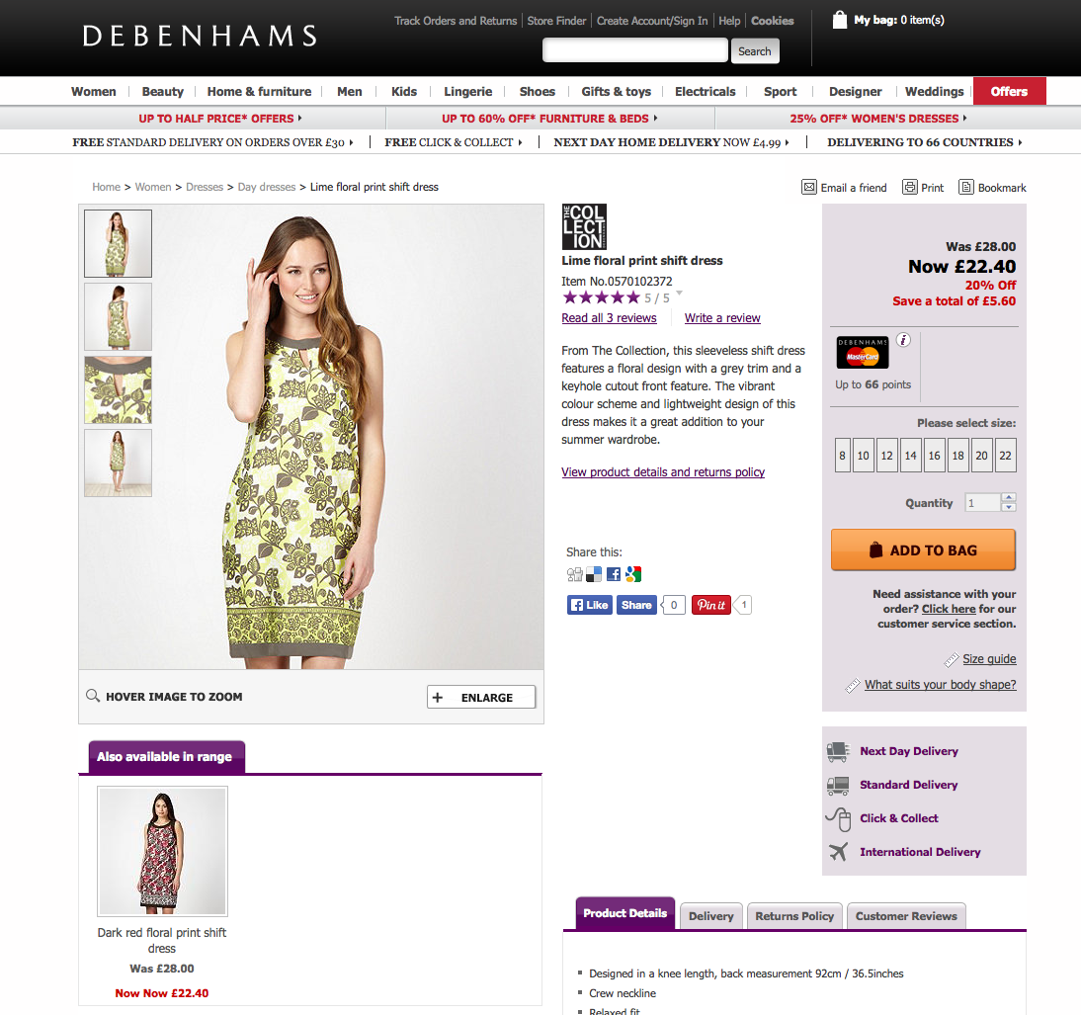
Familiar and learnable

Slide 4
Using contrast for making more/less prominent what it is more/less important.
If you make everything high contrast it becomes hard to communicate to users the visual hierarchy. Thus, the perceived complexity is increased

Slide 5
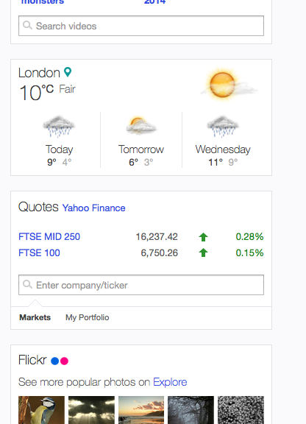
Using contrast for making more/less prominent what it is more/less important. Some examples:

Slide 6
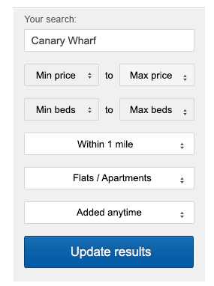
Using contrast for making more/less prominent what it is more/less important. Some examples:

Slide 7
Clear and relevant
By disclosing non-essential information progressively, we ensure content become visible only when it’s relevant to the user. Letting the user see clearly what essential options and functions are available is a fundamental principle of successful user interface design.

Slide 8
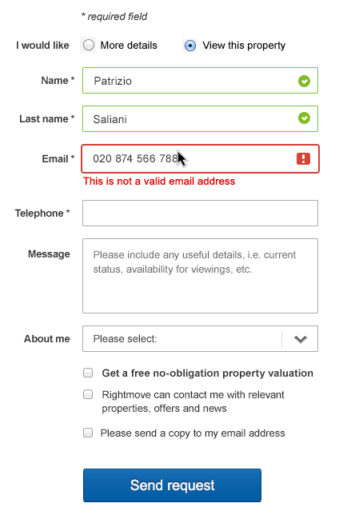
Preventing errors via direct feedback
Feedback is essential to any interaction. The moment users interact with our site, we must offer an indication of success or failure of their actions as early as possible, ideally before they commit to them.

Slide 9
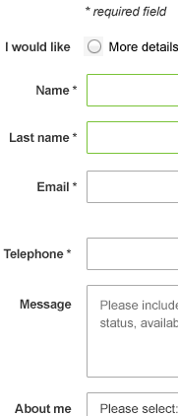
Avoiding repetitions
By reducing cognitive load you make it easier for visitors to grasp the idea behind the system.

Slide 10
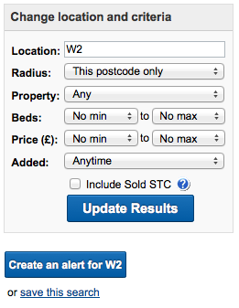
Usable on Tablet devices
Users interact with touch-based user interfaces also with their fingers. So user interface controls have to be big enough to capture fingertip actions without frustrating users with erroneous actions and tiny targets

Slide 11
Simple and friendly
Focus on what’s important. By offering a simple design we don’t distract our visitors, and they will be more likely to do what we want them to do. Icons for example manage to communicate the information clearly as well as being more attractive

Slide 12
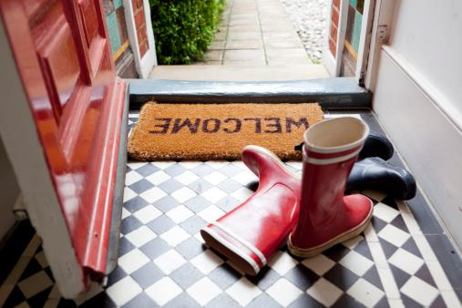
Warm and human
Our photography style should capture the moment, emotions should be real, and the choice of subject, wherever possible, should be authentic. Our images are saturated in color, vibrant and bright.

Slide 13
Predictable and consistent

Slide 18
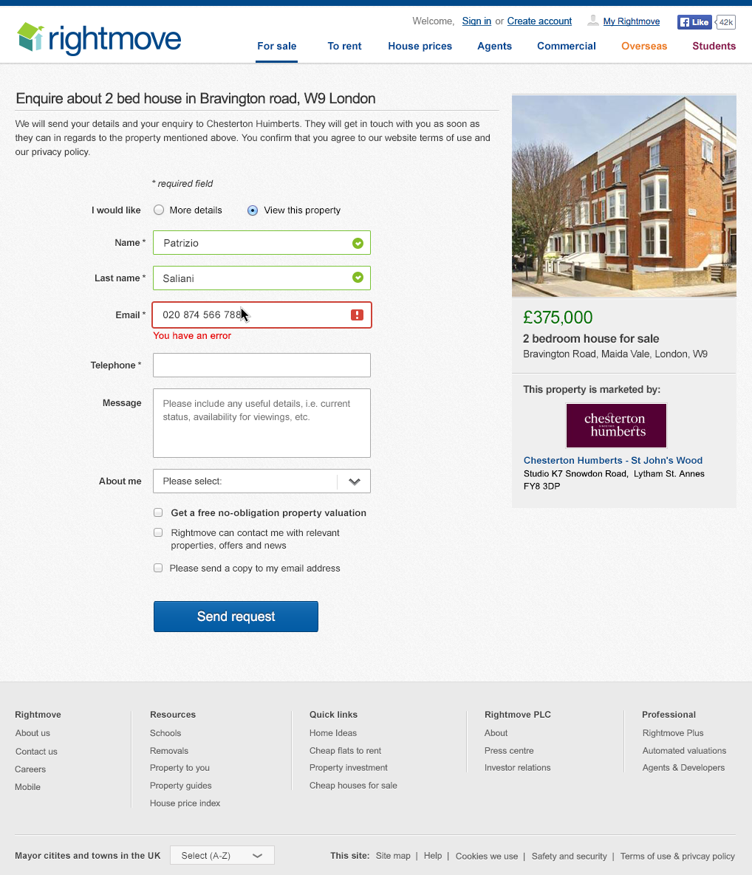

Slide 20
Thank you.
Notes:
Created by: Patrizio Saliani

